Slide 1
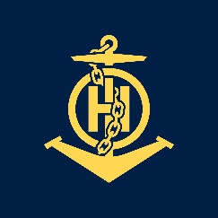
Mr
IHO – NIPPON FOUNDATION
ALUMNI SEMINAR
Khoirul Anwar

Slide 2
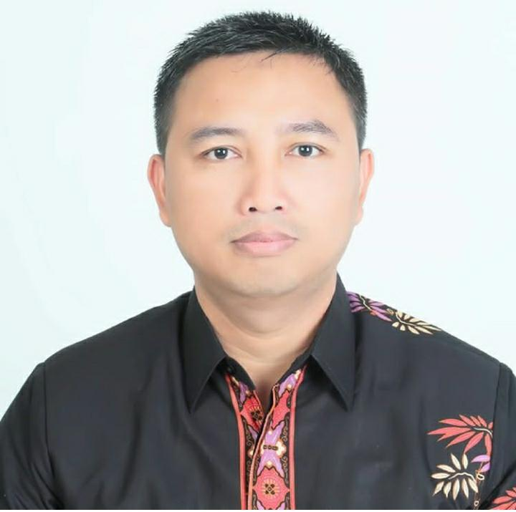
Self introduction
IHO – NIPPON FOUNDATION
ALUMNI SEMINAR
Name | Khoirul Anwar
Alumni year | 2011
Country | INDONESIA
Organization | INDONESIA NAVAL HYDROGRAPHIC OCEANOGRAPHIC CENTRE
Position/Job title | ENC TECHNICAL OFFICER, CHARTING DIVISION
Current job description | ENC MANAGER, MSS ENC ADMINISTRATOR
Please put your photo hee!

Slide 3
My career path and projects / Achievements
IHO – NIPPON FOUNDATION
ALUMNI SEMINAR
I work on Charting Division, Indonesia Naval Hydrographic-Oceanographic Centre (2008 until now)
Have made dozens of paper charts
Have made dozens of ENCs
Maintain 520 ID ENCs as ENC Manager
In the migration process to HPD System
MSS-ENC Administrator

Slide 4
My career path and projects / Achievements
IHO – NIPPON FOUNDATION
ALUMNI SEMINAR
Instructor on Marine Cartography Course:
Bachelor Program, Indonesian Naval College
Diploma Program, Indonesian Naval College
Hydrography Cat-B, Naval Education Center
Training Cat-C Marine Cartography, Pushidrosal
Inservice Training in Charting Division

Slide 5
Lessons learned from CHART Course
IHO – NIPPON FOUNDATION
ALUMNI SEMINAR
By taking Marine Cartography Course, my knowledge on Marine Cartography has improved.
I became confident in making chart, confident to resolve cartography problems such as Hydrographic Data Assessment, Compilation, Production, Chart updating or ENC.

Slide 6
Suggestion for the future
IHO – NIPPON FOUNDATION
ALUMNI SEMINAR
S-100
Requires extensions of technical and human resource capacity for new digital products.
S100 Training for Cartographer (S-10X)
Future of Paper Chart

